Slide 1
Project Assignment
Course : Information Retrieval
Effective Period : 2020

Slide 2
Team Project
Sec. 1.3
Maximum 5 students per team
Topic: Implementation of IR (see the course topics)
Deadline 1: Before Mid Test -> Project Plan
Deadline 2: Before Final Test -> Prototype (in GitHub) and project report

Slide 3
Project Submission
Each team have to submit the following items:
Project Report (Introduction, Method, Results and Discussion, Conclusion)
Source Code (can be GitHub link)
5-minutes Presentation Video
Peer-evaluation form

Slide 4
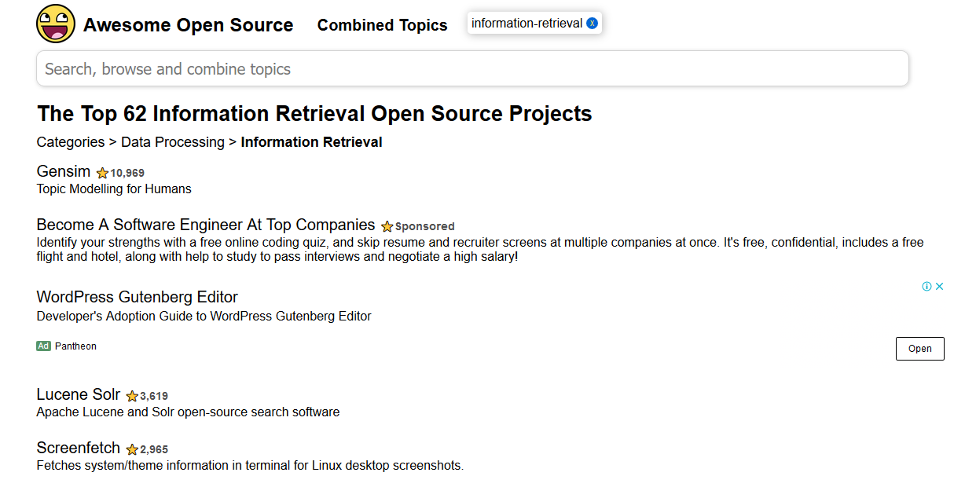
Some Examples
https://awesomeopensource.com/projects/information-retrieval

Slide 5
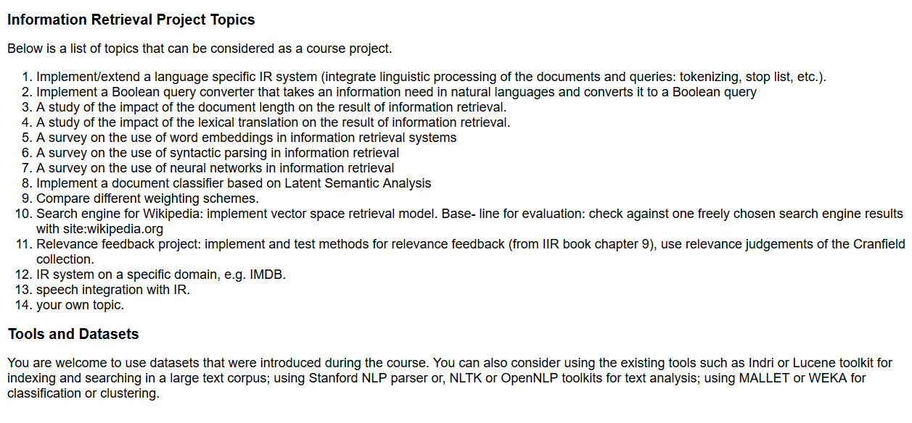
Some Examples
https://cl.lingfil.uu.se/~abasirat/ir/ir_proj_topic.html

Slide 6
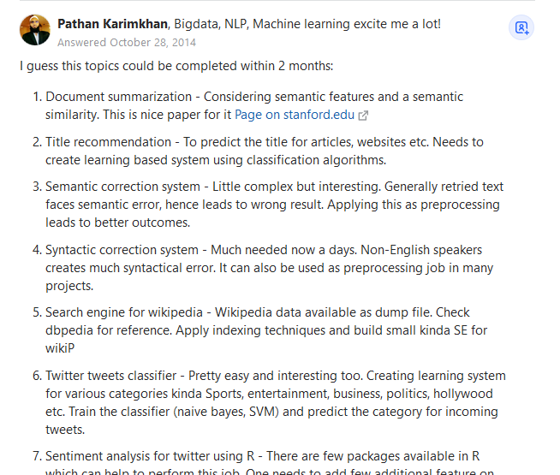
Some Examples
https://www.quora.com/What-are-some-good-course-project-topics-in-Information-Retrieval-and-Web-Search-that-can-be-complemented-in-2-months

Slide 7
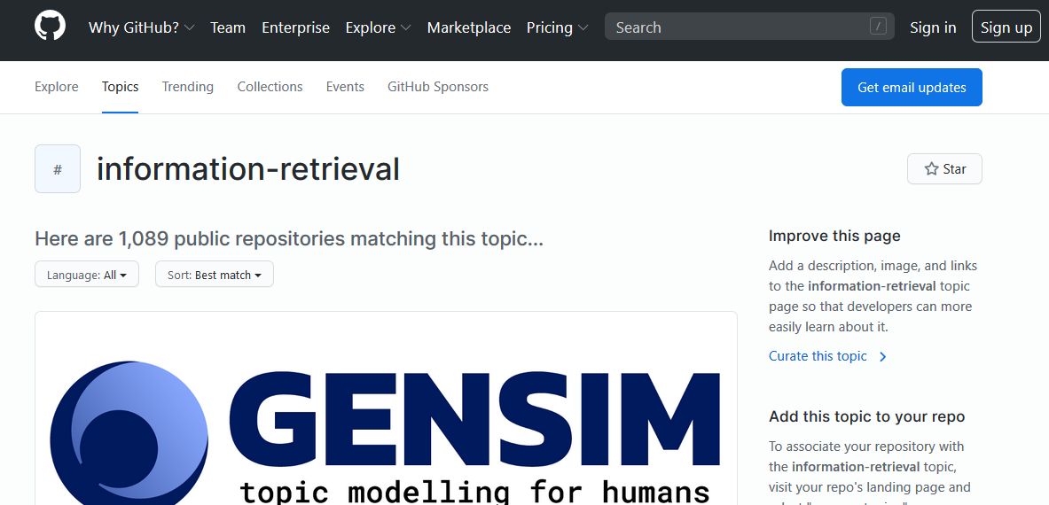
Useful Resources on GitHub
https://github.com/topics/information-retrieval

